Slide 1
BizTalk ESB Integration

Slide 2
Contents
  Integration Strategy
  What is BizTalk
  BizTalk Capabilities
  BizTalk Security
  BizTalk Architecture
  BizTalk Adapters
  Orchestration
  BizTalk Admin Console
  Exception Management
  Business Activity Monitoring
  BizTalk ESB Toolkit

Slide 3
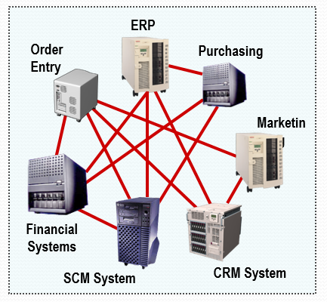
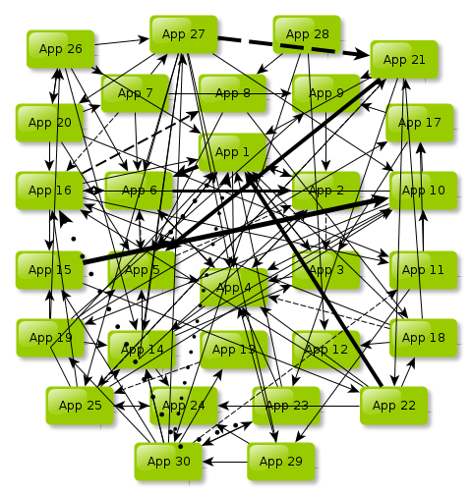
Point-To-Point Integration Architecture
Advantages
Higher performance
Tighter integration
Easier to implement
Disadvantages
Increased complexity
Difficult to monitor the transactions

Slide 4
Enterprise Integration Architecture
E-Business
Web Object
(SOAP & REST)
BPA
(Business Process Automation)
Enterprise Application Integration
Data Integration
SOA
Cloud Integration
Composite app
Security
Strategy & Governance
Intranet System
(HR, ERP, Finance, CRM etc.)
Solution Delivery
Custom System
Legacy System
(E.g. DB2)

Slide 5
What is BizTalk?
BizTalk is the Integration tool developed by Microsoft
BizTalk Server is an application integration platform
BizTalk enables applications to pass messages to each other
BizTalk enables long running transactions for business processes
BizTalk Server connects diverse applications
With more than 15,000 enterprise customers world-wide and more than 80% of the Fortune Global 100 companies using it. We can safely conclude that it is a very successful product.
Microsoft BizTalk Server provides a development and execution environment that orchestrates business processes, both within and between businesses.
BizTalk provides the base services to do powerful application integration across disparate systems and even organizations. Microsoft BizTalk Server is an application server that enables companies to integrate and manage automated business processes by exchanging business documents, within or across organizational boundaries
.

Slide 6
BizTalk Capabilities
EAI – To integrate Homogeneous applications
B2B – To integrate Heterogeneous applications
BPM – To manage the Business process (Orchestration).
BAM – To monitor the Business Activities
BRE – To manage Business Rules.
Messaging
Orchestration
All messages inside BizTalk are XML data. Since XML can be interpreted in any system, BizTalk helps in connectivity

Slide 7
BizTalk Capabilities
It is basically an Integration server with in-built adapters for communication. It helps in Integrating Enterprise Applications at one common point.
Solutions can be developed really fast with BizTalk Server. Effort spent will be less.
Support, Maintenance and updates are easy to manage and maintained.
Its provide guaranty that message will never loss in BizTalk if any technical issue occurs.
It has retried mechanism as well as alternative transport mechanism for message processing.
BizTalk is designed to operate in Multi Server Environment. We can run the application on various servers to manage load and highly Availability.
Advantage for customers on cost saving in terms of development time.
BizTalk has BAM Portal (Business Activity Monitoring Portal) to tracking the message information inside the BizTalk for the Business guys.
BizTalk has a number of Tools like BRE, SSO which be effectively used.
It can be used to communicate with wide range of Legacy Applications. There is always a scope to develop custom

Slide 8
BizTalk Security
Microsoft's Enterprise SSO server is bundled with BizTalk Server.
Enterprise Single Sign-On (SSO) provides services to store and transmit encrypted user credentials across local and network boundaries, including domain boundaries. SSO stores the credentials in the SSO database. Because SSO provides a generic single sign-on solution, middleware applications and custom adapters can leverage SSO to securely store and transmit user credentials across the environment. End users do not have to remember different credentials for different applications.
BizTalk Server’s out-of-the-box adapters (Connectors) support transport-level security where appropriate. Message-level security is supported via Windows Communication Foundation (WCF) adapters. WCF adapters can also be used to support federated authentication, where users authenticated by one organization can access services provided by another based on cross-organizational trust rather than the use of centralized user accounts.
WCF interfaces can be secured with below approaches:
    Authentication: Identification of message sender/requester and message receiver
    Integrity: Signing of message prior to be transmitted
    Confidentiality: Messages should be encrypted before it is to be transmitted

Slide 9
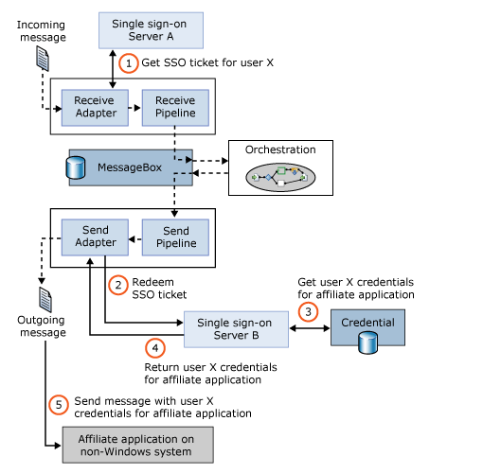
BizTalk Security- ESSO (Enterprise Single Sign On)
Enterprise Single Sign-On stores an encrypted mapping between a user’s Windows user ID and his credentials for one or more affiliate applications in an SSO database. When this user needs to access an affiliate application, the credentials for that application can be looked up in the SSO database by a Single Sign-On (SSO) Server. The diagram below shows how this works.

Slide 10
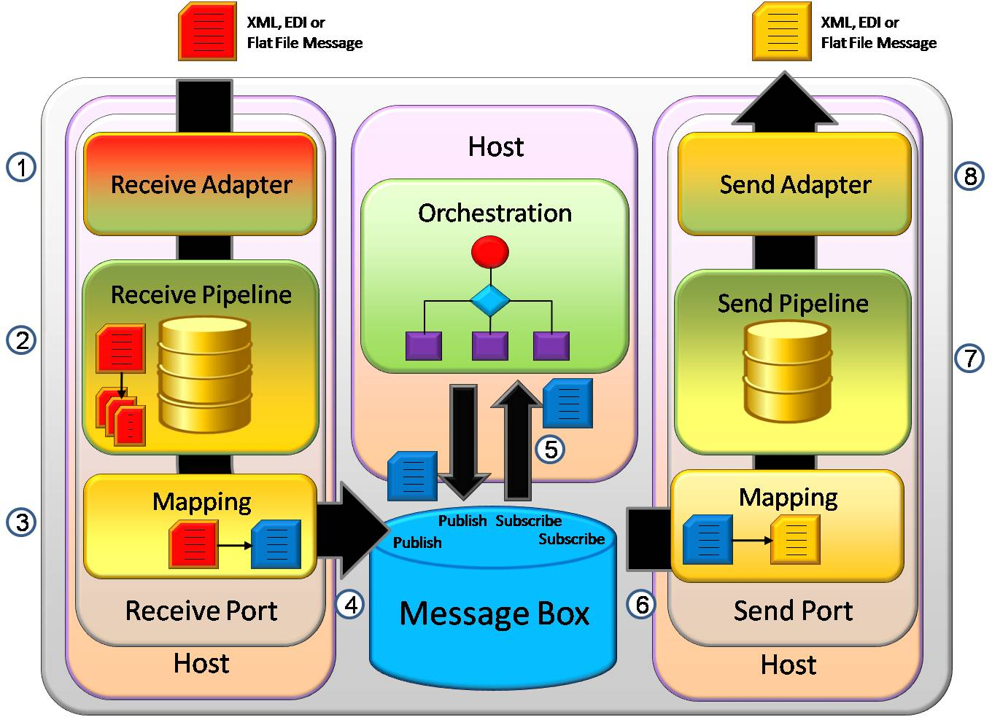
BizTalk Runtime Architecture

Slide 11
BizTalk Adapters for communication
BizTalk has several in-built adapters for communication and also there is scope available for creating custom adapters. Below are mentioned in-build adapters.
File
FTP
HTTP(s)
MQSeries
MSMQ
Logic App
POP3
SFTP
SMTP
SOAP
Window SharePoint Services
WCF-BasicHttp
WCF-Custom
WCF-CustomIsolated
WCF-NETMsmq
WCF-NetTcp
WCF-NetNamedPipe
WCF-WebHttp
WCF-WSHttp

Slide 12
BizTalk Enterprise Adapters
Following is a list of the Line of Business (LOB) adapters provided by Microsoft.
Adapters | Description
PeopleSoft Enterprise | Enables exchange of Component Interface (CI) messages between BizTalk Server and a PeopleSoft system.
JD Edwards OneWorld XE | Enables exchange of Business Function messages between BizTalk Server and a JD Edwards OneWorld system.
JD Edwards EnterpriseOne | Enables exchange of Business Function messages between BizTalk Server and a JD Edwards EnterpriseOne system.
TIBCO Rendezvous | Enables exchange of XML and binary data format messages between BizTalk Server and TIBCO Rendezvous.
TIBCO Enterprise Message Service | Enables exchange of XML and binary data format messages between BizTalk Server and a TIBCO EMS server providing a tightly integrated and reliable application infrastructure.

Slide 13
BizTalk Adapter Pack
The Microsoft BizTalk Adapter Pack includes adapters that enable enterprise applications and databases to interface with each other by using a common adapter framework. Similar to programming to web services, adapters enable clients to program to different enterprise applications. Technically, adapters are a binding to Windows Communication Framework (WCF). The BizTalk Adapter Pack includes the following adapters:
Oracle Database (Oracle Database adapter)
Oracle E-Business Suite (Oracle E-Business adapter)
mySAP Business Suite (SAP adapter). This also includes the .NET Framework Data Provider for mySAP Business Suite (Data Provider for SAP)
Siebel eBusiness Applications (Siebel adapter). This also includes the .NET Framework Data Provider for Siebel eBusiness Applications (Data Provider for Siebel)
SQL Server (SQL adapter).

Slide 14
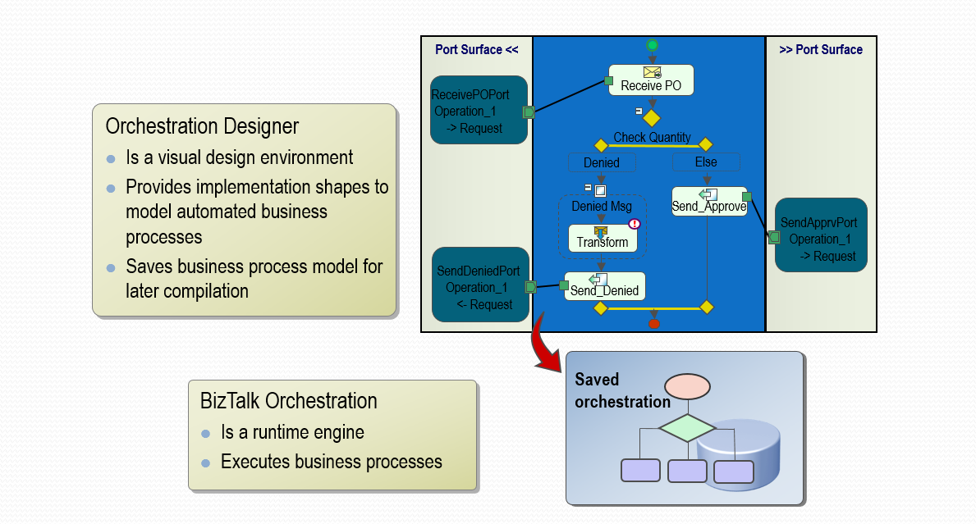
BizTalk Orchestration
Orchestration is a way to implement and automate business process management (BPM).

Slide 15
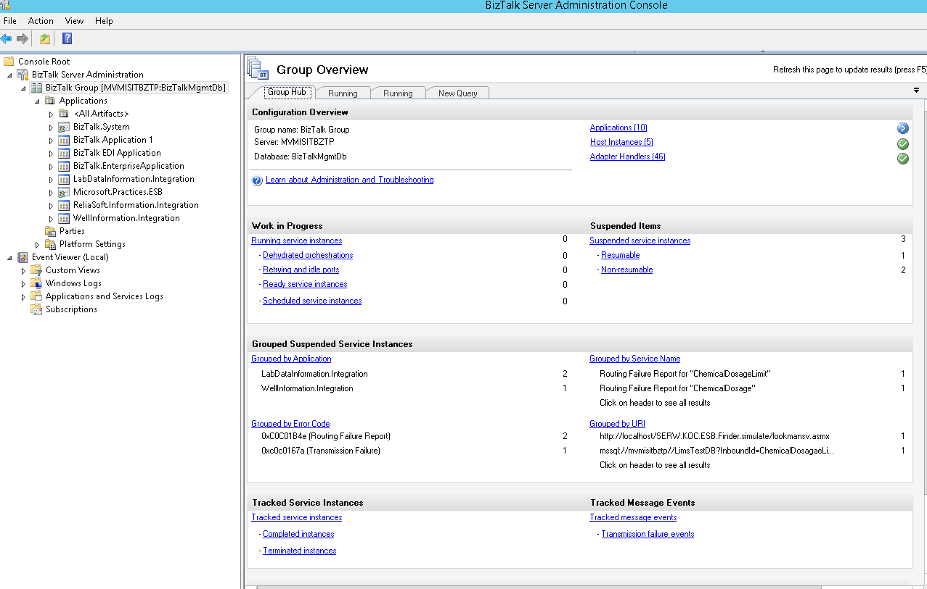
BizTalk Admin Console
The BizTalk Server Administration Console is a Microsoft Management Console (MMC) that you can use to manage and monitor BizTalk Server, and that you can use to deploy and manage your BizTalk Server applications.
The left side of the BizTalk Server Administration Console, the console tree, consists of folders and subfolders that represent different types of artifacts that you can manage.
Application Name
Exception
Exception Details

Slide 16
BizTalk Admin Console
BizTalk Admin Console helps an admin to perform some Administrative tasks like
  Deploying the BizTalk server solutions
  Managing and troubleshooting the integrations
  Configuring send and receiving ports (Connectors)
  Taking reports concerned with messages transferred, application usage etc
  Adding resources to the application
  Managing Orchestration, Maps, Schemas, Pipelines and other artifacts for the application
It is extensively used for
Configuring the integration between Source and Destination systems using adapters. Adapters are a piece of software available to connect with different systems like SQL, SAP, Oracle, File, WCF etc., and many more
Administering the application and logical grouping of the different artifacts available like
  Starting, stopping or scheduling the application(s)/port(s).
  Grouping the BizTalk and .NET assemblies
  Policies
Debugging and Troubleshooting the application in case of any error.

Slide 17
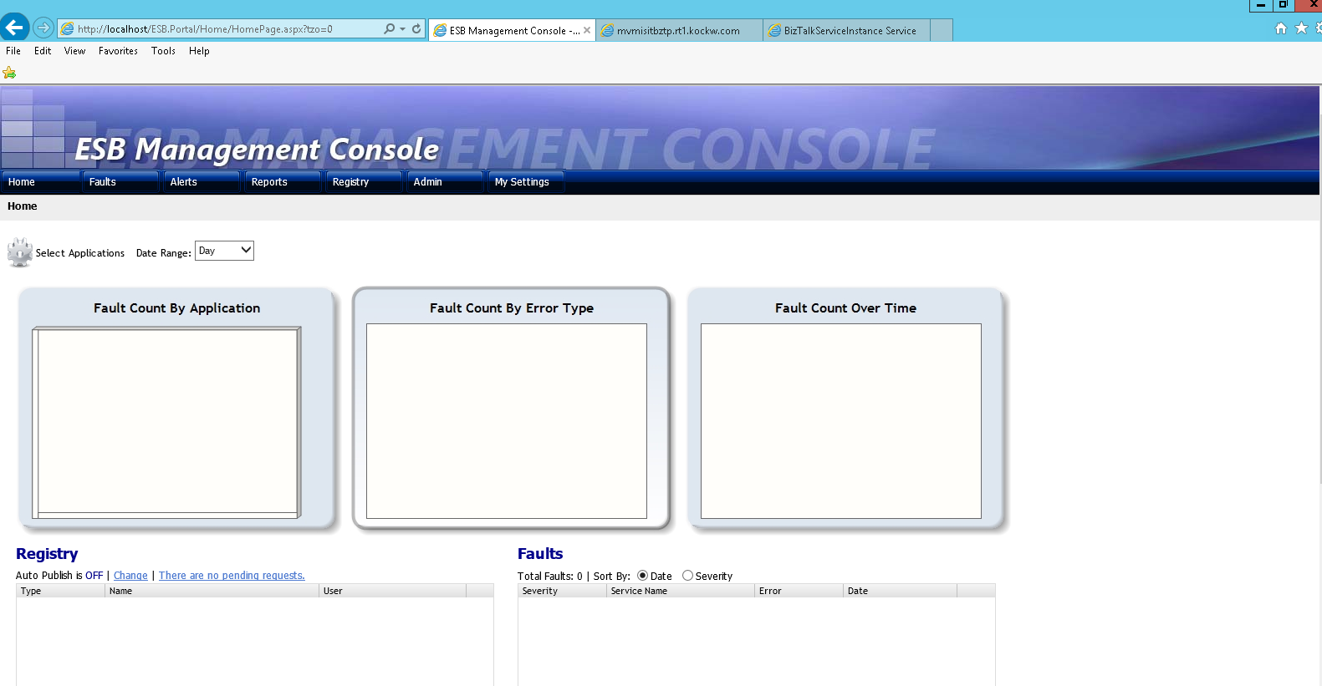
ESB Management Portal
The ​Microsoft BizTalk ESB Toolkit includes a comprehensive Web-based exception and fault message management framework that promotes consistent handling of both system and business exceptions.

Slide 18
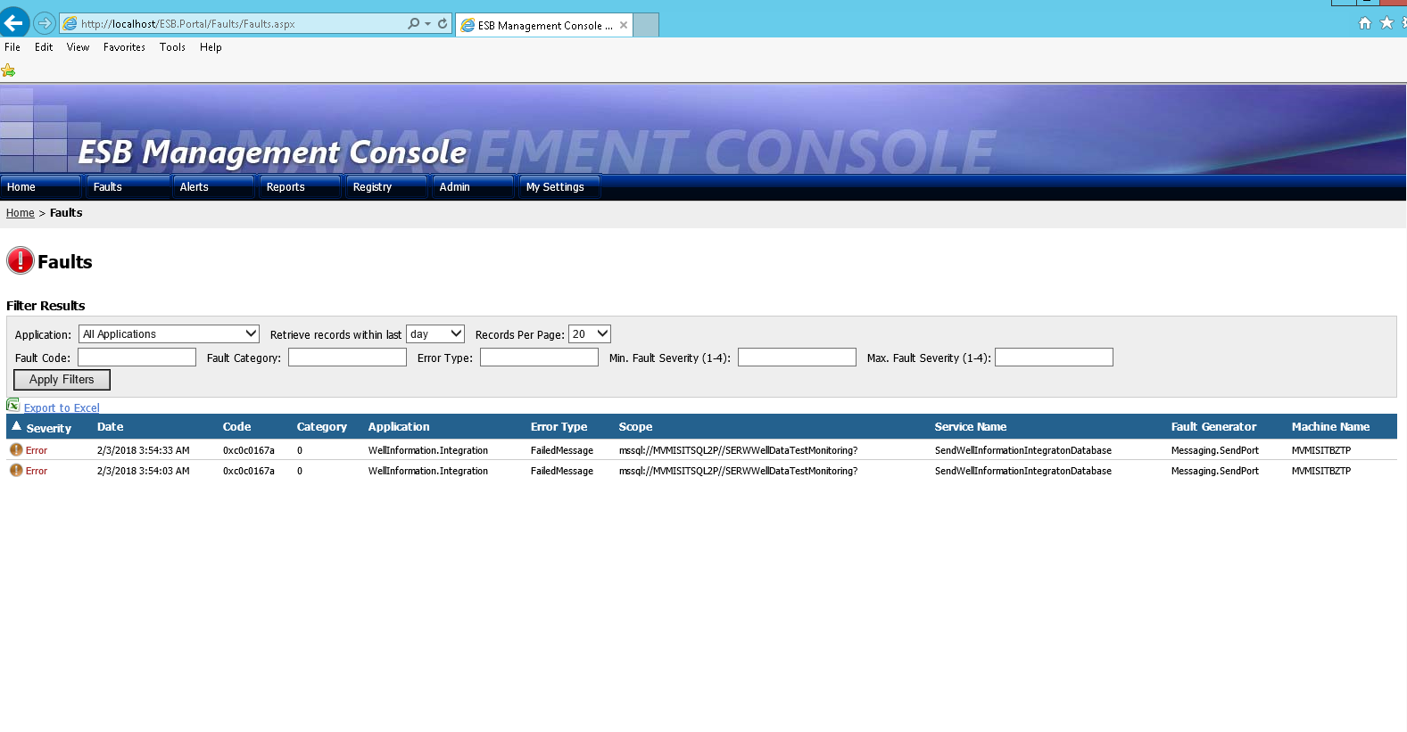
Error Log Details on ESB Management Console
ESB Management Console has ‘fault’ page as below screenshot. This page provide the information about failed messages. We can search fault details on the basis of application or Retrieve records within last list boxes. Also error log can be export as excel by clicking on Export to Excel link.
Exception Details

Slide 19
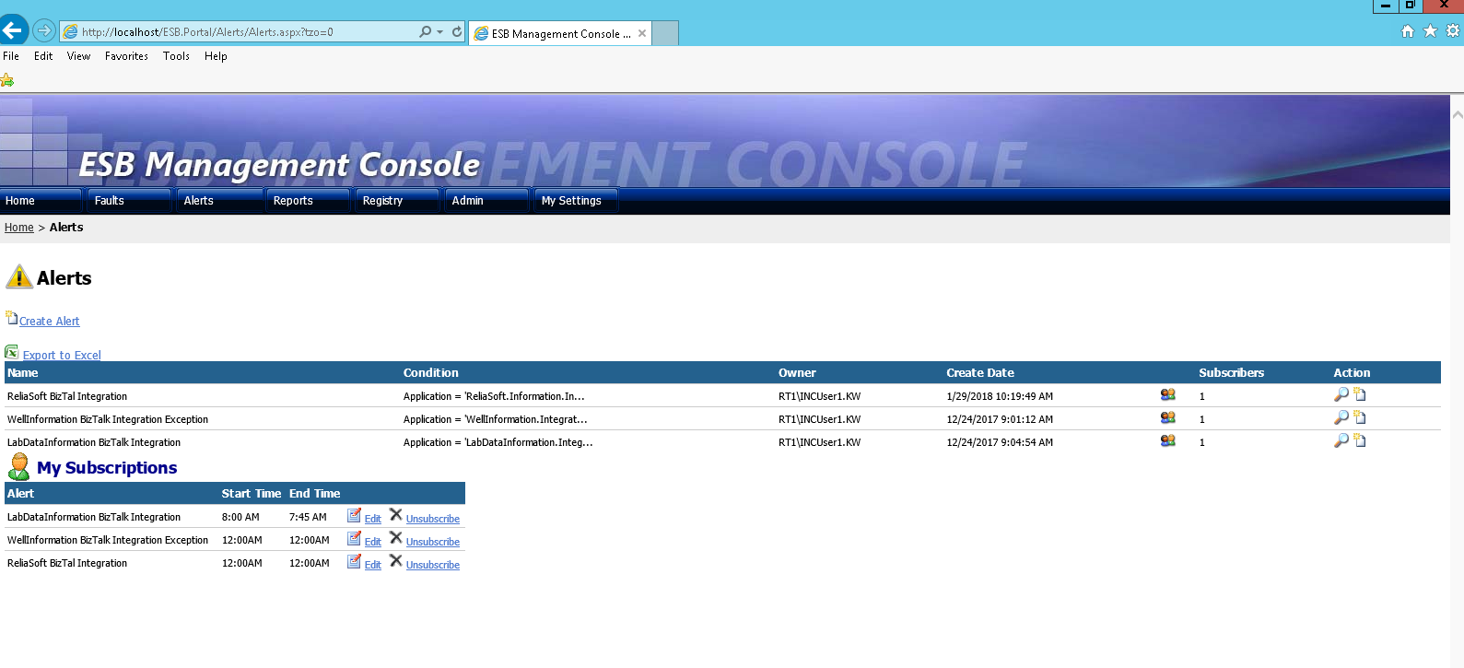
ESB Alert Notification
To allow administrators and users to easily manage ESB applications, the portal also provides an alert and notification mechanism that can generate alerts based on custom conditions and send notifications to subscribers.

Slide 20
Business Activity Monitoring (BAM)
BAM is the optional and important part of BizTalk. Its available when we are installing BizTalk Server.
BAM is used for monitor the data and milestone of the messages in near real time, which are passing thought the BizTalk.
BAM is rich set of Tools for monitoring. It’s available along with BizTalk License. BAM Portal is ASP.NET Component.
Business Activity Monitoring (BAM) is a collection of tools that allow you to manage aggregations, alerts, and profiles to monitor relevant business metrics (called Key Performance Indicators, or KPIs). It gives you end-to-end visibility into your business processes, providing accurate information about the status and results of various operations, processes, and transactions so you can address problem areas and resolve issues within your business.

Slide 21
BizTalk Esb Toolkit
The Microsoft BizTalk ESB Toolkit provides architectural guidance, patterns, and a collection of BizTalk Server and .NET Framework components to simplify the development of an Enterprise Service Bus (ESB) on the Microsoft platform and to allow Microsoft customers to extend their own messaging and integration solutions.
This EBS toolkit comes along with BizTalk Software.
The Microsoft BizTalk ESB Toolkit extends the functionality of BizTalk Server to provide a range of new capabilities focused on building robust, connected, service-oriented applications that incorporate itinerary-based service invocation for lightweight service composition, dynamic resolution of endpoints and maps, Web service and WS-* integration, fault management and reporting, and integration with third-party SOA governance solutions.

Slide 22
Thanks

