Slide 1
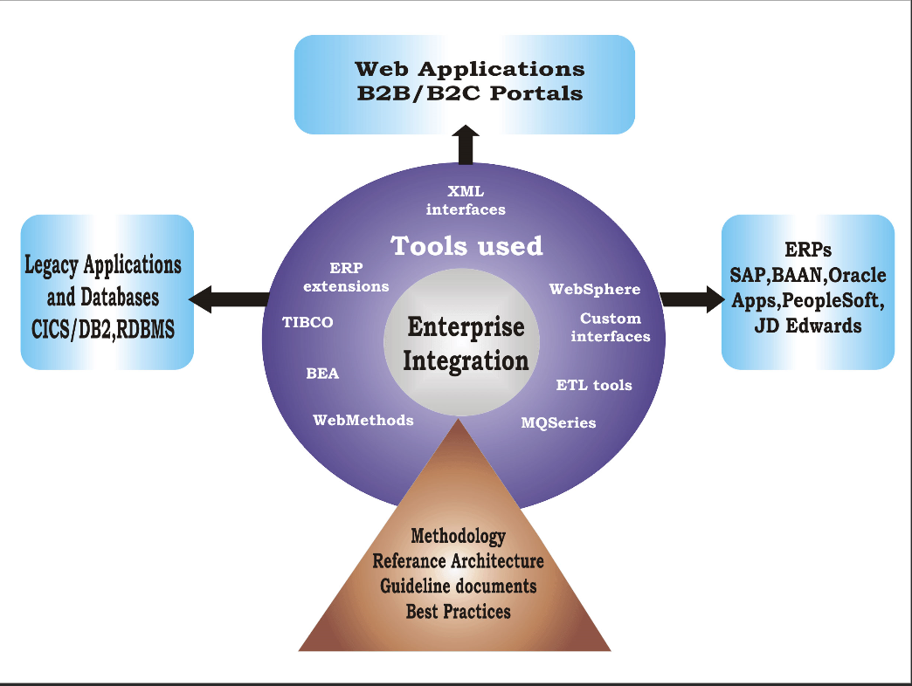
Enterprise Application Integration
EAI solutions provide an integrated approach to connecting the different components of IT infrastructure- people, applications, platforms and databases to enable secure, intra and inter enterprise collaboration.
Origin of EAI
  Interoperability
  Data integration
  Robustness, Stability, and Scalability
BizTalk

Slide 2
Enterprise Application Integration Requirement & Goal
Application Integration Criteria:
Application Coupling
Integration simplicity
Integration Technology
Data Format
Data timeline
Data or functionality
Goal of EAI:
  The seamless integration of business processes for the purposes of conducting business electronically.
  The sharing and/or exchange of data between systems for the purpose of providing a unified interface.
  improve the efficiency and effectiveness of business processes
  create new business processes by connecting existing information systems
  implement mergers and acquisitions
  save the investment in existing systems
Application Integration Options:
File Transfer
Shared Database
Remote Procedure Invocation
Messaging

Slide 3
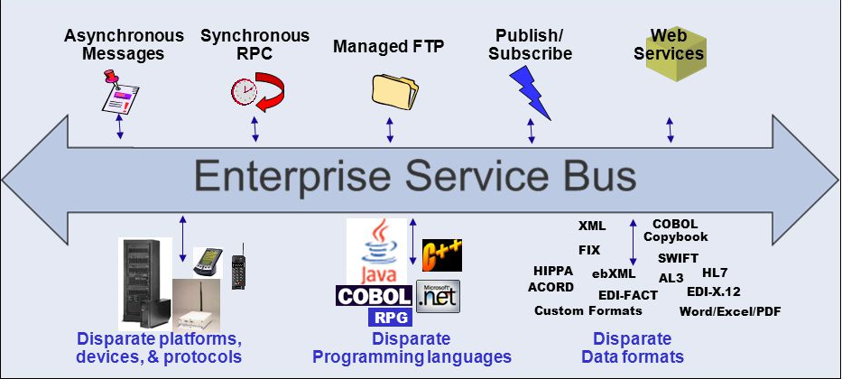
Enterprise Application Integration Architecture
Layers of EAI
Communications
Routing and brokering
Business Intelligence
Types of EAI
Data level
Business Model level
  a. Application program interface level
  b. Method level
  c. User interface level
EAI Software Typology
Point-to-point topology
Hub/ star topology
Bus topology (ESB)

